Slide 1
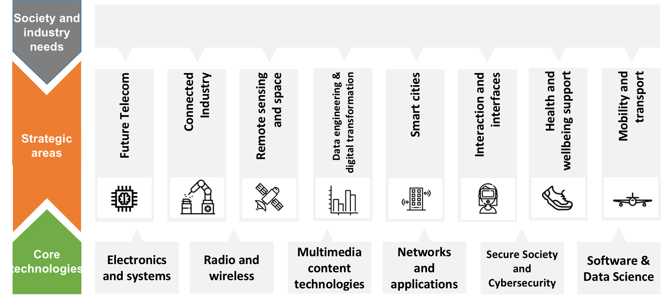
Information Processing and Telecommunications Center
WHO WE ARE
The Information Processing and Telecommunications Center (IPTC) brings together the expertise and resources of a number of highly competitive research groups working in the fields of Electronics, Communications, Networks, Computing and Software.
It is the largest Research Center in UPM, actually the first one in the UPM quality ranking.
1.
4.
180 researchers
283 journal and
conference papers
Bringing expertise in different areas of knowledge on ICT.
High quality research outcomes challenging and advancing the state-of-the-art.
2.
107 competitive
research projects
5.
In national and international R&D and innovation competitive programmes.
13 Ph.D. thesis
Doctoral works on hot topics
3.
70 research contracts
2018
LAST AVAILABLE AGGREGATED FIGURES
Solving the needs of industry partners and contributing to value creation and innovation.
Notes:
http://www.flaticon.com/

