Slide 1
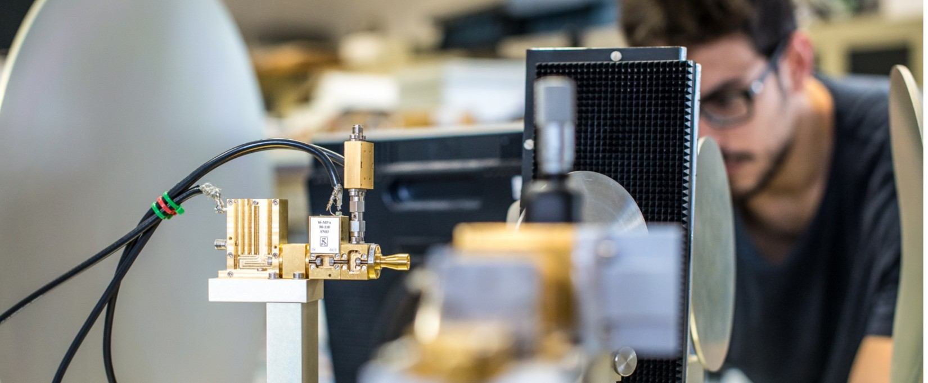
Information Processing and Telecommunications Center
iptc
Madrid, 2019

Slide 2
Who We Are
ICT at Universidad Politécnica de Madrid
iptc
The Information Processing and Telecommunications Center is a research initiative in the Universidad Politécnica de Madrid (Spain) that brings together the expertise, background and strategy for the future of a cluster of competitive research groups specialized in the fields of Electronics, Communications, Networks, Computing and Software.
http://www.upm.es
http://www.iptc.upm.es
Disruption
Multidisciplinarity
Multidisciplinar expertise
Short & long-term challenges
Technologies for the future

Slide 3
What We Do
Applied research on ICT, innovative engineering solutions, education and training
Society and industry needs
Future Telecom
Connected
Industry
Remote sensing
and space
Data engineering &
digital transformation
Smart cities
Interaction and
interfaces
Health and
wellbeing support
Mobility and
transport
Strategic
areas
Core technologies
Electronics and systems
Radio and wireless
Multimedia content technologies
Networks and applications
Secure Society and Cybersecurity
Software & Data Science

Slide 4
IPTC in facts and figures
2018
1.
2.
3.
|161 Ph.D. researchers
107 competitive research projects
70 industry projects
Bringing expertise in different areas of knowledge on ICT.
In national and international R&D and innovation competitive programmes.
Solving the needs of industry partners and contributing to value creation and innovation.
4.
5.
6.
283 journal and conference papers
6 patents and SW registries
13 doctoral thesis
High quality research outcomes challenging and advancing the state-of-the-art.
Applied research outcomes ready to be exploited in products and services.
Doctoral works on hot topics and activities.

Slide 5
Future Telecoms
Signals, media, networks and security
Signals & Media
Core technologies
Next generation media and internet
Hardware systems design
Infrastructure for the I.o.T.
Next generation media
Advanced media
5G
SW defined networking
Signal, image and video processing and understanding
Broadcast and multimedia
Cybersecurity, digital identity, privacy
Key areas are advanced electronics and circuit design (up to millimeter waves), 5G core technologies, advanced array and data processing, next generation media and next generation internet, including prominently the internet of things.
Social networks and the full chain of issues and aspects in Cybersecurity are also areas of activity in the Center.

Slide 6
Data Engineering & Digital Transformation
Target sector orientation, data exploitation, advanced modelling
Target sector
Telecommunication technologies
Data engineering
Retail
Industry
Cloud technologies
Business intelligence
Agro-food
Health
Computer and communications
Data exploit. and deep learning
Telecom.
Finance
Large scale platforms
Modelling, simulation and advanced visualization
Focused on digital transformation of several niche sectors. Big Data techniques and technologies, Business Intelligence tools, Very Advanced Simulation and Visualization, Artificial Intelligence, Large-Scale Platform Design and Cloud technologies

Slide 7
Connected Industry
Data-driven, cognitive computation, Big Data, IoT
Smart industry
IoT & Data analytics
Computing & communications
Data-driven industry
Predictive maintenance
Cloud and virtualization infrastr.
Robotics
Big data, advanced analytics
Internet services
Machine Learning. Cognitive computation
IoT: retail, transport, environment
Agile & lean SW development
Aligned with the objectives of the EC initiative of Digitising European Industry (the manufacturing sector in the EU accounts for 2 million enterprises and 60% of productivity growth). Outstanding activity in the core technologies to advance the concept of Smart Industry, including world-class research in IoT and data analytics.

Slide 8
Smart Cities
Spaces, resources, citizens
City services management
Smart spaces
Technologies
Intelligent Transport
Mobility and personalization
Internet of Things
Resources management
Personal and social experiences
Data-driven Management
Contextual information systems
Citizen-oriented services
Mobile
The Smart City concept, in the IPTC view, includes not only the technologies to make the city services management more efficient and sustainable, but also those that allow to provide its citizens and visitors more and richer personal and social experiences. Thus the Smart City concept extends itself into the Smart Spaces, including specific indoor, public and private, leisure and work spaces.

Slide 9
Interaction and Interfaces
Augmented, virtual, natural and smart
Augmented, virtual and natural interfaces
Smart spaces technologies
Applications
Augmented and natural interaction
Biometrics
Industries
Advanced graphics and visualization
Localization
Leasure and learning
3D and holographics
Context interpretation
Training and rehabilitation
Augmented, Virtual and Natural Interfaces are the key focus of a part of the IPTC. Combined with other smart spaces concepts, one of the basic challenges is to provide enriched experiences to the user. Application fields range from accessibility to leisure and from design to rehabilitation.

Slide 10
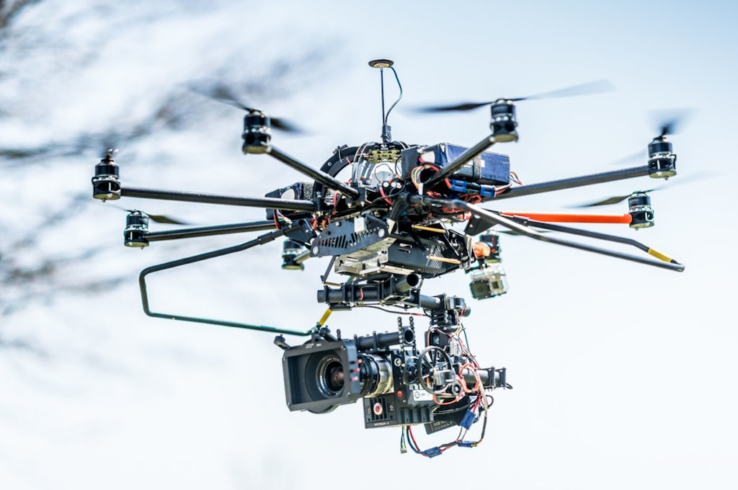
Mobility and Transport
Air, surface, multimodal
ICT for transport and mobility
Air transport
Surface transport
Communications Systems
Air traffic control and management
Smart and connected car
Infrastructure design
RPAS and UAV
Ship monitoring and surveillance
Accurate positioning and guidance
Airport ecosystem
Multimodality
ICT for improved, efficient and friendly transport are one of the privileged fields of work in the IPTC. The area includes the development of techniques for all means of transport and for multimodality management. Emphasis is in communications systems and infrastructure design, and in accurate positioning, planning and guidance.

Slide 11
Defense, Remote Sensing & Space
Devices, algorithms, systems and applications
Devices and systems
Algorithms
Applications
Special-purpose circuits and antennas
Detection and enhancement
Defense
Radars
Image and reconstruction
RPAS & UAV based
Infrared, ultrasound and
multispectral technologies
Location and tracking
Satellite communications and earth observation
Research at the device-level, such as special-purpose circuits and antennas, algorithm-level, including signal processing and detection and enhancement, and complete working systems, based on multispectral, infrared, ultrasound and radar technologies.

Slide 12
Consulting and other support services
Public organizations, SMEs and large companies
DIGITAL TRANSFORMATION
Diagnosis and definition of technology needs and strategy
Tailored R&D to extend existing products and services to the digital world
Workflow analysis and process improvement for organizational change
TECH CONSULTING & STRATEGIC PARTNERSHIPS
Technology watch services
Consultancy for specific technological challenges (e.g. digital transformation)
Cooperative projects focused on medium and short term innovation actions
TECHNOLOGY TRANSFER AND TRAINING
Specialized sessions and seminars on targeted technologies
Made-to-measure training pills and courses
Technology transfer and licensing

Slide 13
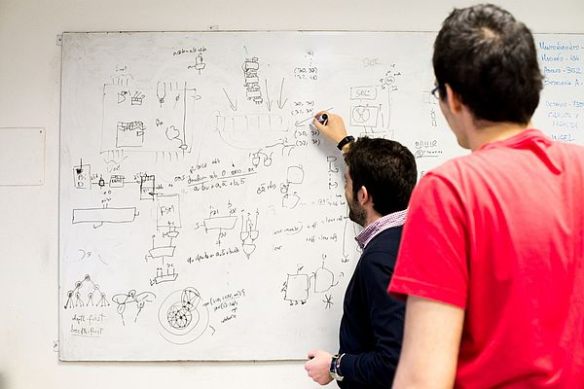
Education
Continuous education for companies and public and private institutions
Graduate and master programmes
Doctoral programmes
Made-to-measure training
IPTC offers or collaborates in the delivery of scientific and technology oriented ad-hoc courses and academic degrees in the fields of its activity (e.g. smart cities, cybersecurity, big data, radar and defense, etc.).
The Center may help to define and diagnose continuous education needs, organize sessions and conferences, provide access to experts in specific technology fields, etc.

Slide 14
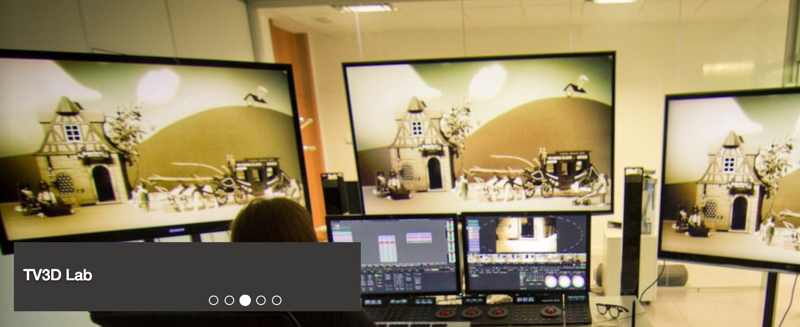
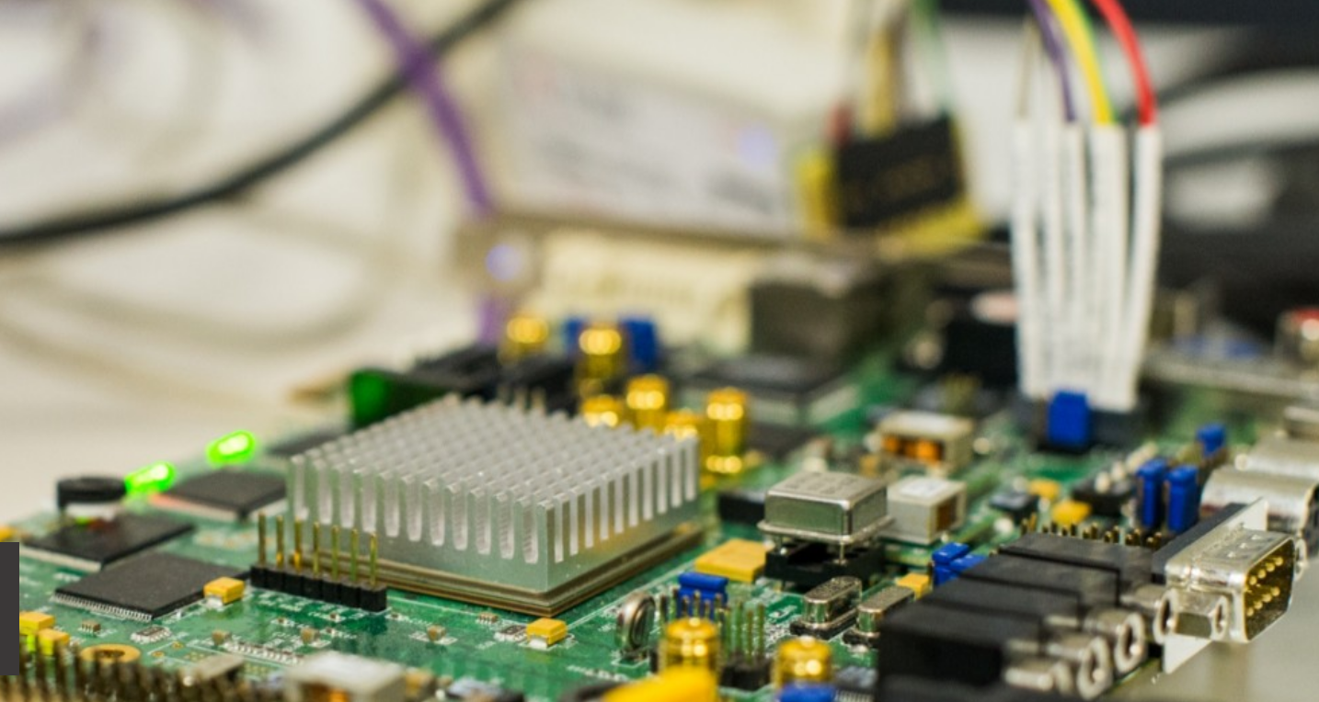
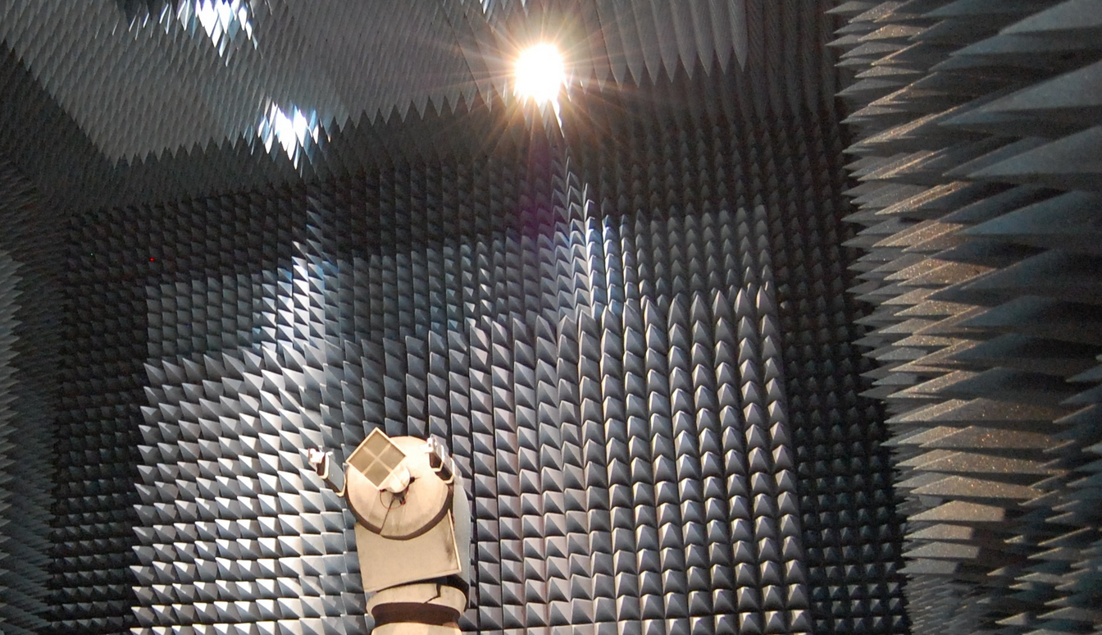
Facilities and infrastructures
Enabling research, prototyping, user testing
Multimedia technologies Labs
Living Labs
Integrated circuits and electronics Labs
Anechoic Chambers and Radar Labs

Slide 15
INFORMATION PROCESSING AND
TELECOMMUNICATIONS CENTER
Universidad Politécnica de Madrid
iptc@iptc.upm.es
http://www.iptc.upm.es

